Slide 1
Distributed-File Systems
Dr. Muazzam A. Khan

Slide 2
Chapter 17 Distributed-File Systems
Background
Naming and Transparency
Remote File Access
Stateful versus Stateless Service
File Replication
An Example: AFS

Slide 3
Distributed File System
DFS is a File System, that supports sharing of files and resources in the form of persistent storage over a network.
The first file servers were developed in the 1970s.
Sun’s Network File System (NFS) became the first widely used distributed file system after its introduction in 1985.
A DFS is a file system whose clients, servers, and storage devices are dispersed among the machines of a Distributed System or intranet.

Slide 4
Distributed File System
DFS service activity has to be carried out across the network, and instead of a single centralized data repository, the system has multiple and independent storage devices.
The distinctive features of a DFS are the multiplicity and autonomy of clients and servers in the system.

Slide 5
DFS Structure
Service – Software entity running on one or more machines and providing a particular type of function to an unknown client
Server – Service software running on a single machine
Client – Process that can invoke a service using a set of operations that forms its client interface
Client interface of a DFS should be transparent, i.e., not distinguish between local and remote files

Slide 6
Clients and Servers
A file server provides file services to clients.
A client interface for a file service is formed by a set of primitive file operations:
  Creating a file.
  Deleting a file.
  Reading from a file.
  and Writing to a file.

Slide 7
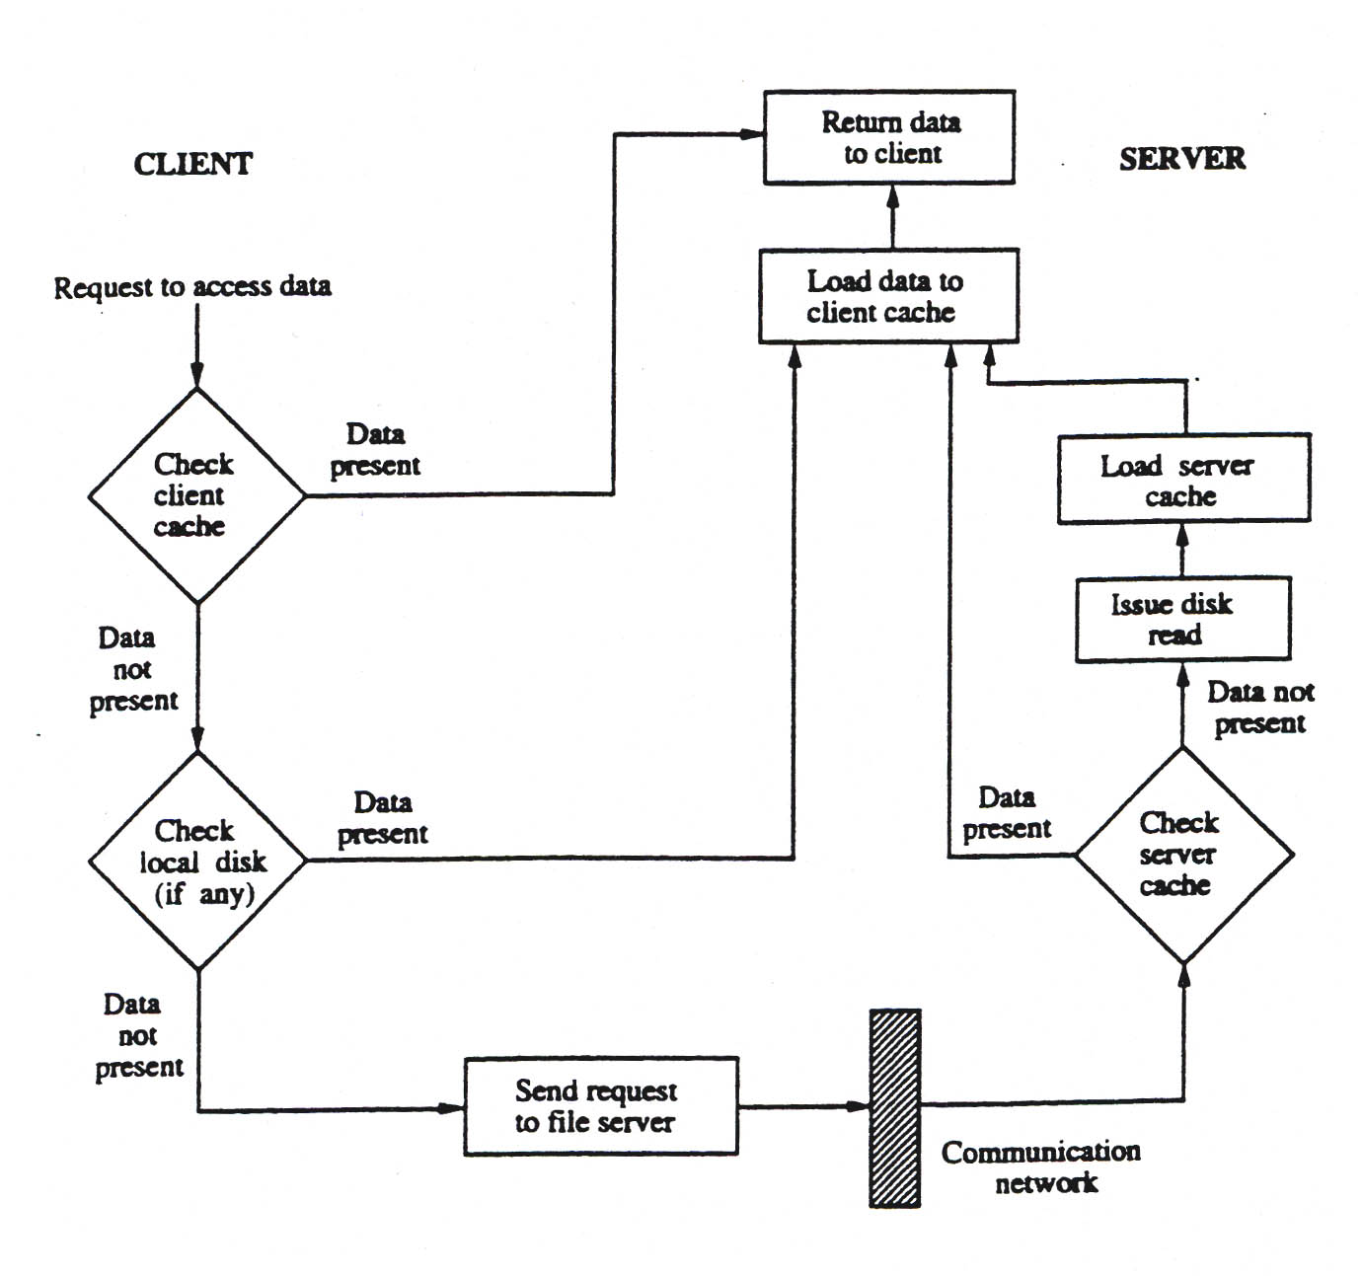
Data Access in DFS

Slide 8
Naming and Transparency
Naming – mapping between logical and physical objects
Multilevel mapping – abstraction of a file that hides the details of how and where on the disk the file is actually stored
A transparent DFS hides the location where in the network the file is stored. Ideally, a DFS should appear to its clients to be a conventional, centralized file system.
The multiplicity and dispersion of its servers and storage devices should be made invisible.
For a file being replicated in several sites, the mapping returns a set of the locations of this file’s replicas; both the existence of multiple copies and their location are hidden

Slide 9
Naming Structures
Location transparency – file name does not reveal the file’s physical storage location
Location independence – file name does not need to be changed when the file’s physical storage location changes

Slide 10
Naming Schemes Approaches
Files named by combination of their host name and local name; guarantees a unique system wide name
Attach remote directories to local directories, giving the appearance of a coherent directory tree;
Total integration of the component file systems
  A single global name structure spans all the files in the system
  If a server is unavailable, some arbitrary set of directories on the machines also becomes unavailable

Slide 11
Performance
The most important performance measurement of a DFS is the amount of time needed to satisfy service requests.
  In conventional systems, this time consists of a disk-access time and a small amount of CPU-processing time.
  In a DFS, however, a remote access has the additional overhead attributed to the distributed structure.
A DFS should provide multiple client processes on multiple machines not just accessing but also updating the same files.
Concurrency control or locking may be either built into the file system or be provided by an add-on protocol

Slide 12
Distributed Data Store
A Distributed Data Store is a network in which a user stores his or her information on a number of peer network nodes.
Most of the peer to peer networks do not have distributed data stores in that the user's data is only available when their node is on the network.
  FreeNet.
  MNet.
  Andrew File System (AFS).
  BitTorrent
  GNUnet.
  Secure File system (SFS)
  Global File System (GFS)
  SVK – Distributed Version Control.
  Groove shared workspace, used for DoHyki.

Slide 13
Remote File Access
Remote-service mechanism is one transfer approach
Reduce network traffic by retaining recently accessed disk blocks in a cache, so that repeated accesses to the same information can be handled locally
  If needed data not already cached, a copy of data is brought from the server to the user
  Accesses are performed on the cached copy
  Files identified with one master copy residing at the server machine, but copies of (parts of) the file are scattered in different caches
  Cache-consistency problem – keeping the cached copies consistent with the master file

Slide 14
Cache Location – Disk vs. Main Memory
Advantages of disk caches
  More reliable
  Cached data kept on disk are still there during recovery and don’t need to be fetched again
Advantages of main-memory caches:
  Permit workstations to be diskless
  Data can be accessed more quickly
  Performance speedup in bigger memories
  Server caches (used to speed up disk I/O) are in main memory regardless of where user caches are located;

Slide 15
Cache Update Policy
Write-through – write data through to disk as soon as they are placed on any cache
  Reliable, but poor performance
Delayed-write – modifications written to the cache and then written to the server later
  Some data may be overwritten before they are written back, and so need never be written at all
  Poor reliability; unwritten data will be lost whenever a user machine crashes
  Variation – scan cache at regular intervals and flush blocks that have been modified since the last scan (Time Based)
  Variation – write-on-close, writes data back to the server when the file is closed
    Best for files that are open for long periods and frequently modified

Slide 16
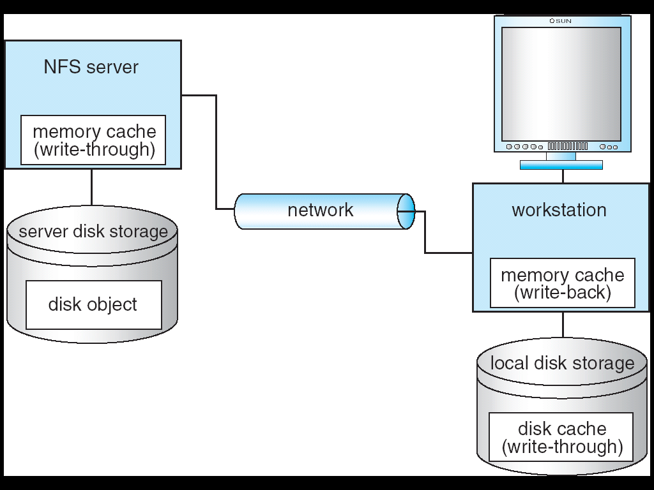
Cachefs and its Use of Caching

Slide 17
Consistency
Is locally cached copy of the data consistent with the master copy?
Client-initiated approach
  Client initiates a validity check
  Server checks whether the local data are consistent with the master copy
Server-initiated approach
  Server records, for each client, the (parts of) files it caches
  When server detects a potential inconsistency, it must react

Slide 18
Comparing Caching and Remote Service
In caching, many remote accesses handled efficiently by the local cache; most remote accesses will be served as fast as local ones
Servers are contacted only occasionally in caching (rather than for each access)
  Reduces server load and network traffic
  Enhances potential for scalability
Remote server method handles every remote access across the network; penalty in network traffic, server load, and performance
Total network overhead in transmitting big chunks of data (caching) is lower than a series of responses to specific requests (remote-service)

Slide 19
Caching and Remote Service (Cont.)
Caching is superior in access patterns with infrequent writes
  With frequent writes, substantial overhead incurred to overcome cache-consistency problem
Benefit from caching when execution carried out on machines with either local disks or large main memories
Remote access on diskless, small-memory-capacity machines should be done through remote-service method
In caching, the lower intermachine interface is different from the upper user interface

Slide 20
Stateful File Service
Mechanism
  Client opens a file
  Server fetches information about the file from its disk, stores it in its memory, and gives the client a connection identifier unique to the client and the open file
  Identifier is used for subsequent accesses until the session ends
  Server must reclaim the main-memory space used by clients who are no longer active
Increased performance
  Fewer disk accesses
  Stateful server knows if a file was opened for sequential access and can thus read ahead the next blocks

Slide 21
Stateless File Server
Avoids state information by making each request self-contained
Each request identifies the file and position in the file
No need to establish and terminate a connection by open and close operations

Slide 22
Distinctions Between Stateful & Stateless Service
Failure Recovery
  A stateful server loses all its volatile state in a crash
    Restore state by recovery protocol based on a dialog with clients, or abort operations that were underway when the crash occurred
    Server needs to be aware of client failures in order to reclaim space allocated to record the state of crashed client processes (orphan detection and elimination)
  With stateless server, the effects of server failure and recovery are almost unnoticeable
    A newly reincarnated server can respond to a self-contained request without any difficulty

Slide 23
Distinctions (Cont.)
Penalties for using the robust stateless service:
  longer request messages
  slower request processing
  additional constraints imposed on DFS design
Some environments require stateful service
  A server employing server-initiated cache validation cannot provide stateless service, since it maintains a record of which files are cached by which clients
  UNIX use of file descriptors and is inherently stateful; servers must maintain tables to map the file descriptors, and store the current offset within a file

Slide 24
File Replication
Replicas of the same file reside on failure-independent machines
Improves availability and can shorten service time
Naming scheme maps a replicated file name to a particular replica
  Existence of replicas should be invisible to higher levels
  Replicas must be distinguished from one another by different lower-level names
Updates – replicas of a file denote the same logical entity, and thus an update to any replica must be reflected on all other replicas
Demand replication – reading a nonlocal replica causes it to be hard so need to cached locally,

Slide 25
An Example: AFS
A distributed computing environment (Andrew) developed at C-Mellon University, purchased by IBM and released as Transarc DFS, now open sourced as Open AFS
AFS tries to solve complex issues such as uniform name space, location-independent file sharing, client-side caching (with cache consistency), secure authentication (via Kerberos)
  Also includes server-side caching (via replicas), high availability
  Can span 5,000 workstations

Slide 26
ANDREW (Cont.)
Clients are presented with a partitioned space of file names: a local name space and a shared name space
Dedicated servers, called Vice, present the shared name space to the clients as an homogeneous, identical, and location transparent file hierarchy
Workstations run the Virtue protocol to communicate with Vice, and are required to have local disks where they store their local name space
Servers collectively are responsible for the storage and management of the shared name space

Slide 27
ANDREW (Cont.)
Clients and servers are structured in clusters interconnected by a backbone LAN
A cluster consists of a collection of workstations and a cluster server and is connected to the backbone by a router
A key mechanism selected for remote file operations is whole file caching
  Opening a file causes it to be cached, on the local disk

Slide 28
ANDREW Shared Name Space
Andrew’s volumes are small component units associated with the files of a single client
A fid identifies a Vice file or directory - A fid is 96 bits long and has three equal-length components:
  volume number
  vnode number – is use as an index into an array (containing the inodes of files in a single volume)
  uniquifier – allows reuse of vnode numbers, there by keeping certain data structures.
Fids are location transparent; therefore, file movements from server to server do not invalidate cached directory contents

Slide 29
ANDREW File Operations
Andrew caches entire files form servers
  A client workstation interacts with Vice servers only during opening and closing of files
  The OS on each work station intercept file system calls and forward them to a client level process on the work station, this process is called venus.
Venus – caches files from Vice when they are opened, and stores modified copies of files back when they are closed
Reading and writing bytes of a file are done by the kernel without Venus intervention on the cached copy
Venus caches contents of directories and symbolic links, for path-name translation

Slide 30
ANDREW Implementation (Cont.)
Venus manages two separate caches:
  one for status
  one for data
LRU (least Recently Used ) algorithm used to keep each of them bounded in size
The status cache is kept in virtual memory to allow rapid servicing of stat (file status returning)
The data cache is resident on the local disk, but the UNIX I/O buffering mechanism does some caching of the disk blocks in memory that are transparent to Venus

Slide 31
Issues in Design of AFS
Client Mobility
Security
Authentication
Protection
Heterogeneity

Slide 32
Windows DFS
To unite files on different computers into a single namespace
Make it easy to build a single, hierarchal view of multiple file servers and file server shares on your network
To display files in a single directory structure regardless of what server the files are on

Slide 33
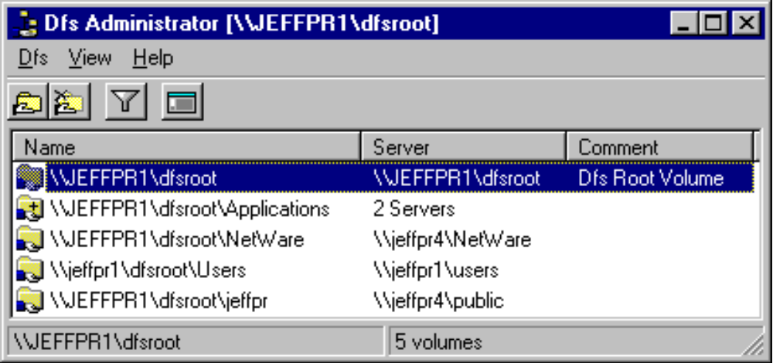
Administration
DFS Provides tools to add and remove shares as necessary

Slide 34
Administration (Continued)
Easy to replace servers since each node in the DFS is assigned a logical name that points to a file share
It Can point a particular share to a new node while the current node is being replaced

Slide 35
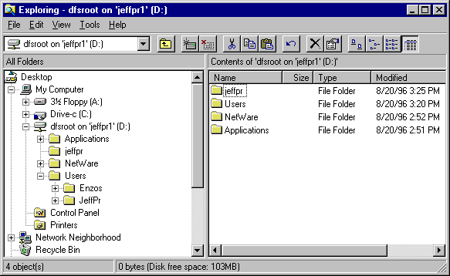
User View
Maps just like a regular Windows drive

Slide 36
Load Balancing
If volumes are unavailable, DFS will hand off request to an alternate volume if available
Example:
  If 300 users require access to one volume, DFS can split users among copies of 2 or more servers to balance the load

Slide 37
Name Transparency
Eliminates the need for end users to know where the information is physically stored
Eases updating to accommodate additional storage
Example:
  Users do not need to know the location of physical storage, so it can be swapped out behind the scenes to accommodate additional storage

Slide 38
End of Chapter

Slide 39
Fig. 17.01

